Slide 1
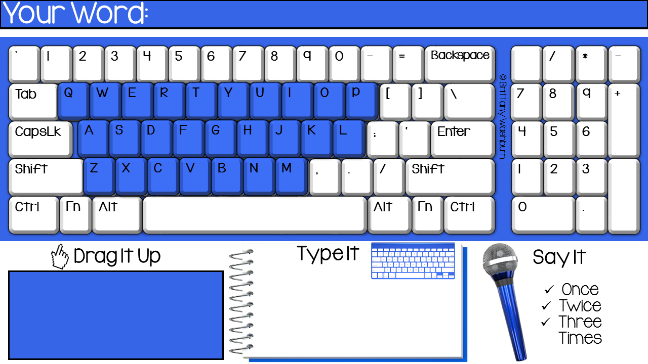
do
do

Slide 2
do
do

Slide 3
do
do

Slide 4
eat
eat

Slide 5
eat
eat

Slide 6
eat
eat

Slide 7
four
four

Slide 8
four
four

Slide 9
four
four

Slide 10
get
get

Slide 11
get
get

Slide 12
get
get

Slide 13
good
good

Slide 14
good
good

Slide 15
good
good

Slide 16
have
have

Slide 17
have
have

Slide 18
have
have

Slide 19
he
he

Slide 20
he
he

Slide 21
he
he

Slide 22
into
into

Slide 23
into
into

Slide 24
into
into

Slide 25
like
like

Slide 26
like
like

Slide 27
like
like

Slide 28
must
must

Slide 29
must
must

Slide 30
must
must

Slide 31
new
new

Slide 32
new
new

Slide 33
new
new

Slide 34
no
no

Slide 35
no
no

Slide 36
no
no

Slide 37
now
now

Slide 38
now
now

Slide 39
now
now

Slide 40
on
on

Slide 41
on
on

Slide 42
on
on

Slide 43
our
our

Slide 44
our
our

Slide 45
our
our

Slide 46
out
out

Slide 47
out
out

Slide 48
out
out

Slide 49
please
please

Slide 50
please
please

Slide 51
please
please

Slide 52
pretty
pretty

Slide 53
pretty
pretty

Slide 54
pretty
pretty

Slide 55
ran
ran

Slide 56
ran
ran

Slide 57
ran
ran

Slide 58
ride
ride

Slide 59
ride
ride

Slide 60
ride
ride

Slide 61
saw
saw

Slide 62
saw
saw

Slide 63
saw
saw

Slide 64
say
say

Slide 65
say
say

Slide 66
say
say

Slide 67
she
she

Slide 68
she
she

Slide 69
she
she

Slide 70
so
so

Slide 71
so
so

Slide 72
so
so

Slide 73
soon
soon

Slide 74
soon
soon

Slide 75
soon
soon

